Slide 1
Probability Concepts
Class 1 (Part 1):
Introduction, Rules, & Relationships

Slide 2
Probability as a Numerical Measure
Increasing Likelihood of Occurrence
0
.5
1
Probability:
The event
is very
unlikely
to occur.
The occurrence
of the event is
just as likely as
it is unlikely.
The event
is almost
certain
to occur.

Slide 3
Probability as a Numerical Measure
P - denotes a probability.
A, B, and C - denote specific events.
P (A) - denotes the probability of event A occurring.

Slide 4
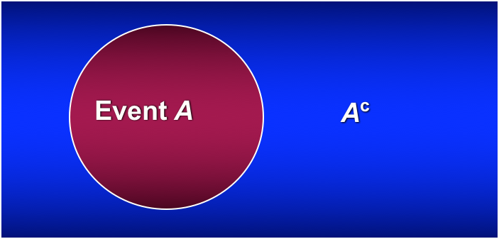
Complement
The complement of event A consists of all outcomes in which the event A does not occur.
P( A ) = 1 – P(A)
Or
P(A^{c}) = 1- P(A)

Slide 5
Assigning Probabilities
1. Classical Method
Assigning probabilities based on the assumption
of equally likely outcomes
2. Relative Frequency Method
Assigning probabilities based on experimentation
or historical data; an empirical probability
3. Subjective Method
Assigning probabilities based on judgment

Slide 6
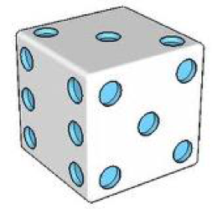
1. Classical Method - Count and Divide
If an experiment has n possible outcomes, this method would assign a probability of 1/n to each outcome.
Experiment: Rolling a die
Sample Space: S = {1, 2, 3, 4, 5, 6}
Probabilities: Each sample point has a
1/6 chance of occurring
P (5) = 1/6
P (Not 5) = 5/6 (Complement)
P (8) = 0
P (1 or 2 or 3 or 4 or 5 or 6) = 1

Slide 7
2. Relative Frequency Method
A survey was conducted among 4776 college students who were asked, How often do you wear a seat belt when riding in a car? The frequencies were as follows:
Seat belt usage | # of Students | Count & Divide | Probability
Never | 125 | 125/4776 | 0.0262
Rarely | 324 | 324/4776 | 0.0678
Sometimes | 552 | 552/4776 | 0.1156
Most of the time | 1257 | 1257/4776 | 0.2632
Always | 2518 | 2518/4776 | 0.5272
Total | 4776 |  | 1.0000
What percentage of respondents answered always? 52.72% What percentage of respondents answered never or rarely? 9.4%

Slide 8
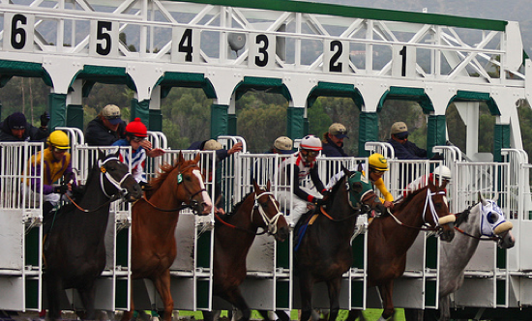
3. Subjective Method
Based on personal judgment and experience. Not a measured frequency.
We can use any data available as well as our
experience and intuition, but ultimately a probability
value should express our degree of belief that the
experimental outcome will occur.

Slide 9
Relationship Rules
1. Mutually Exclusive
2. Collectively Exhaustive
3. Intersection of 2 Events “And”
4. Union of 2 Events “OR”
5. Addition Law “OR”
6. Conditional Probabilities “Given”
7. Multiplication Law “AND"
8. Independence vs. Dependence

Slide 10
1. Mutually Exclusive
Both events cannot occur simultaneously;
The probability that two events happen together equals 0
P (Passing and Failing) = 0
P(Heads and Tails)=0
P(Win Lottery and Lose Lottery)=0

Slide 11
2. Collectively Exhaustive
List of all possible outcomes
The probability of all possible outcomes must equal 1
P (Passing or Failing) = 1
P(Heads or Tails) = 1
P(Win Lottery or Lose Lottery)=1
P (A or A-) ≠ 1
A or A- are not collectively exhaustive

Slide 12
Mutually Exclusive and/or Collectively Exhaustive
Coin Flip Head and Tail
ME and CE
Turning Left and Turning Right
ME Not CE
Being on Campus & Eating at Wendy’s
Not ME and Not CE
Turning Left and Using a turn signal
Not ME and Not CE

Slide 13
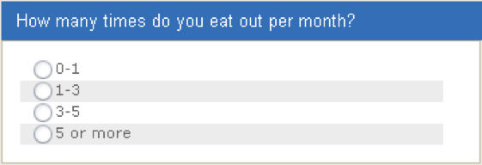
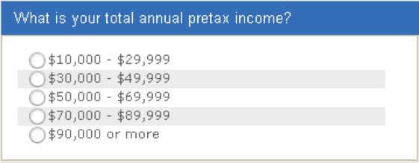
Survey Response Items
Responses are exhaustive, but do not provide mutually exclusive categories.
The response categories do not overlap, but they are not collectively exhaustive.
At minimum, two specific characteristics define a good list of response options for survey questions. First, the categories (response options) must be mutually exclusive, which means they do not overlap with one another. Second, survey response options must be collectively exhaustive, meaning they provide all possible options that could comprise a response list.

Slide 14
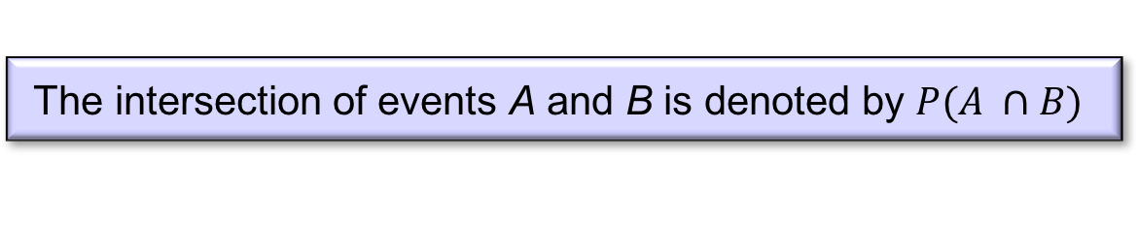
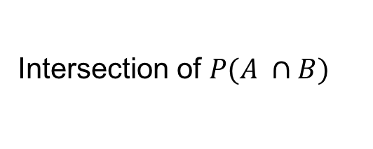
3. Intersection of Two Events “And”
The intersection of events A and B is the set of all
sample points that are in both A and B.
The intersection of events A and B is denoted by $P(A ∩B)$
Sample Space
Event A
Event B
Intersection of $P(A ∩B)$

Slide 15
4. Union of Two Events “Or”
The union of events A and B is the event containing
all sample points that are in A or B or both.
The union of events A and B is denoted by P(A U B)
Sample Space
Event A
Event B
Union of A U B

Slide 16
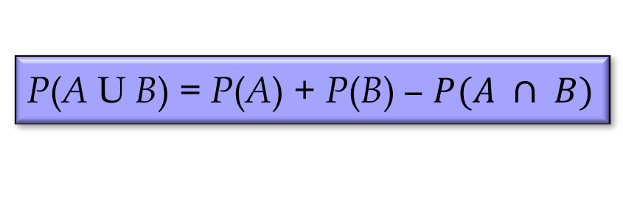
5. General Law of Addition “OR”
The addition law provides a way to compute the
probability of event A, or B, or both A and B occurring.
The law is written as:
P(A U B) = P(A) + P(B) − $P(A ∩ B)$

Slide 17
6. Conditional Probability “Given”
The probability of an event given that another event has occurred is called a conditional probability.
The conditional probability of A given B is denoted by P(A|B).
A conditional probability is computed as:
IF
Of
Given

Slide 18
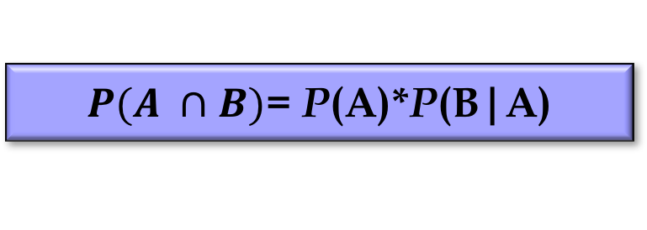
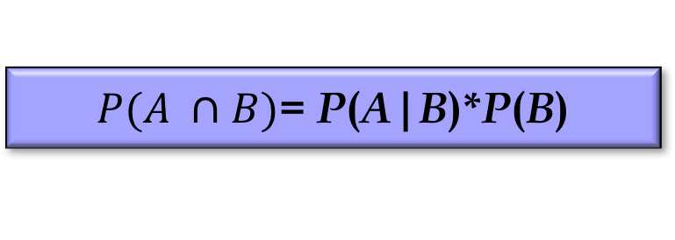
7. General Multiplication Law
The multiplication law provides a way to compute the
probability of the intersection of two events.
The law is written as:
$P(A ∩B)$= P(A)*P(B|A)
Or:
$P(A ∩B)$= P(A|B)*P(B)
Only when the events are independent does the joint probability equal the product of the individual probabilities.

Slide 19
Independence & Dependence
Statistical Independence occurs when the outcome of one event is in no way connected with other event.
If the probability of event A is not changed by the
existence of event B, we would say that events A and B are independent.
Statistical Dependence occurs when the outcome of one event affects the occurrence of some other event.

Slide 20
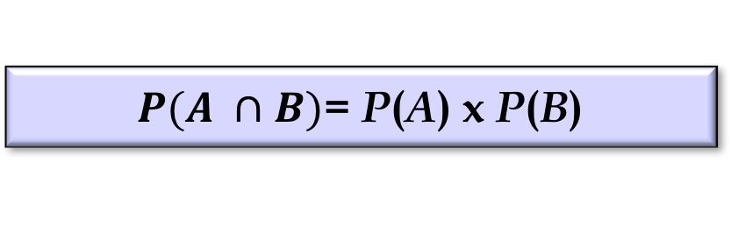
Independent Events Formulas
If the events are independent, the multiplication law can be used when two or more events happen at the same time
$P(A ∩B)$= P(A) x P(B)
The General Law of Multiplication will follow after a discussion of conditional probabilities.

Slide 21
Independent Events Formulas
If the probability of event A is not changed by the existence of event B, we would say that events A and B are independent.
Two events A and B are independent if:
P(A|B) = P(A)
P(B|A) = P(B)
or

Slide 22
Mutual Exclusiveness and Independence
Do not confuse the notion of mutually exclusive events with that of independent events.
Two events with non zero probabilities cannot be both mutually exclusive and independent.
If one mutually exclusive event is known to occur,
the other cannot occur.; thus, the probability of the
other event occurring is reduced to zero (and they
are therefore dependent).
Two events that are not mutually exclusive, might or might not be independent.

Slide 23
Probability Concepts
Class 1:
In-Class Practice Problems

Slide 24
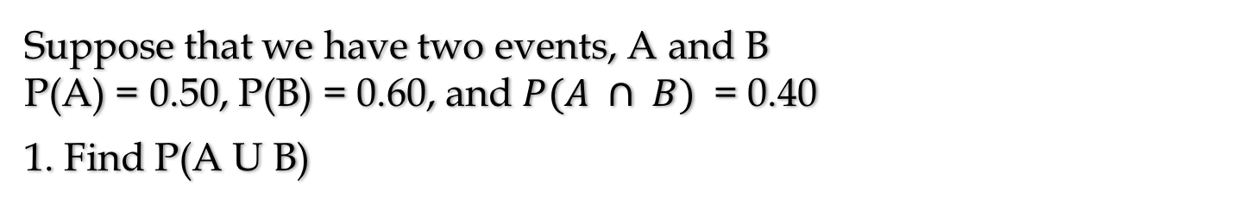
Problem 1
Suppose that we have two events, A and B
P(A) = 0.50, P(B) = 0.60, and $P(A ∩ B)$ = 0.40
1. Find P(A U B)

Slide 25
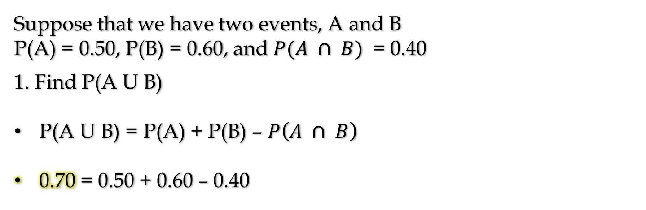
Problem 1 (Solutions)
Suppose that we have two events, A and B
P(A) = 0.50, P(B) = 0.60, and $P(A ∩ B)$ = 0.40
1. Find P(A U B)
P(A U B) = P(A) + P(B) – $P\left(A ∩ B\right)$
0.70 = 0.50 + 0.60 – 0.40

Slide 26
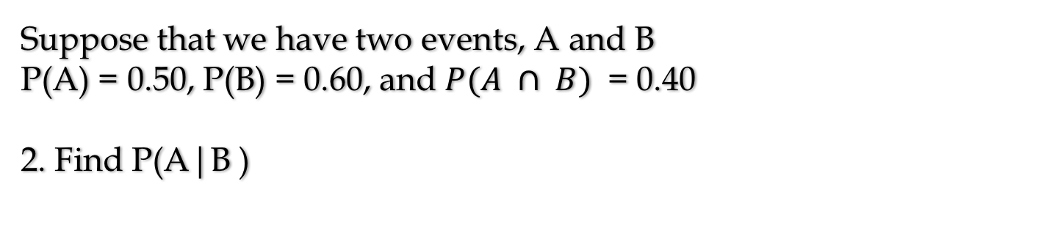
Problem 2
Suppose that we have two events, A and B
P(A) = 0.50, P(B) = 0.60, and $P(A ∩ B)$ = 0.40
2. Find P(A|B )

Slide 27
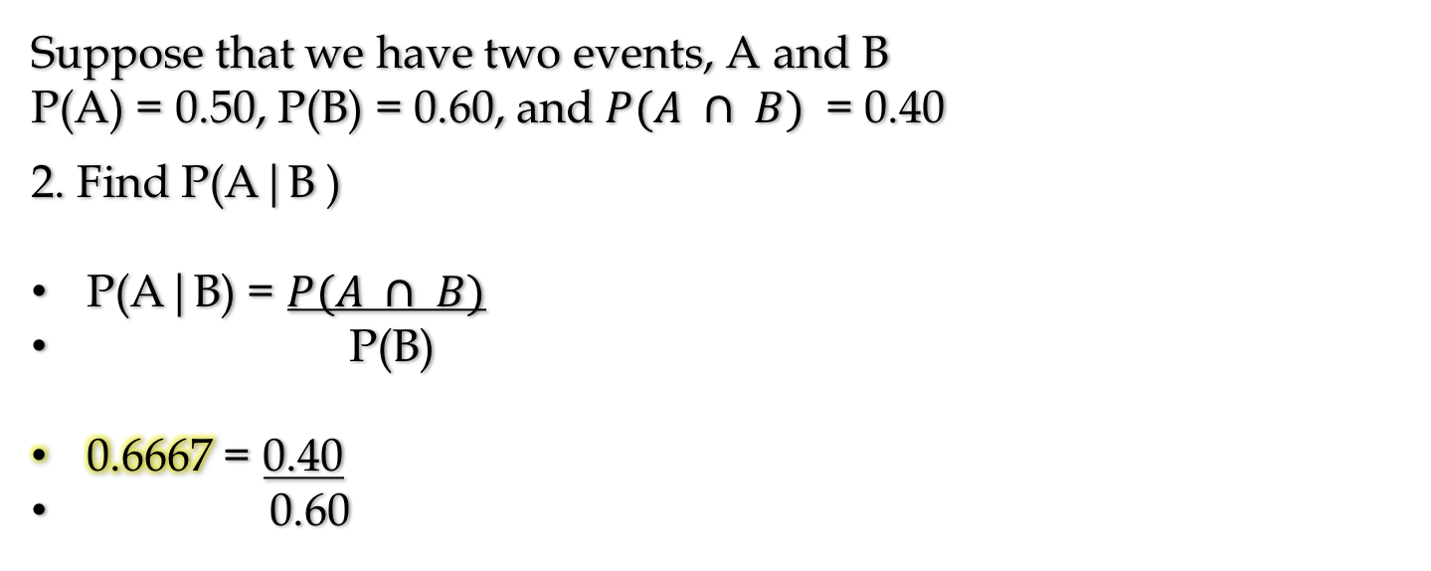
Problem 2 (Solutions)
Suppose that we have two events, A and B
P(A) = 0.50, P(B) = 0.60, and $P(A ∩ B)$ = 0.40
2. Find P(A|B )
P(A|B) = $P(A ∩ B)$
P(B)
0.6667 = 0.40
0.60

Slide 28
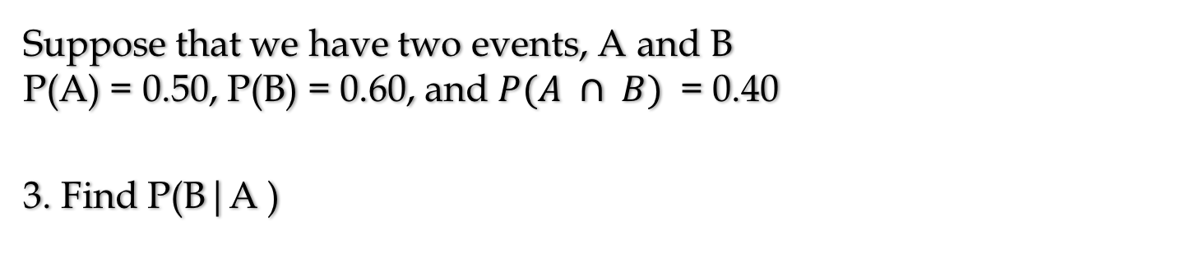
Problem 3
Suppose that we have two events, A and B
P(A) = 0.50, P(B) = 0.60, and $P(A ∩ B)$ = 0.40
3. Find P(B|A )

Slide 29
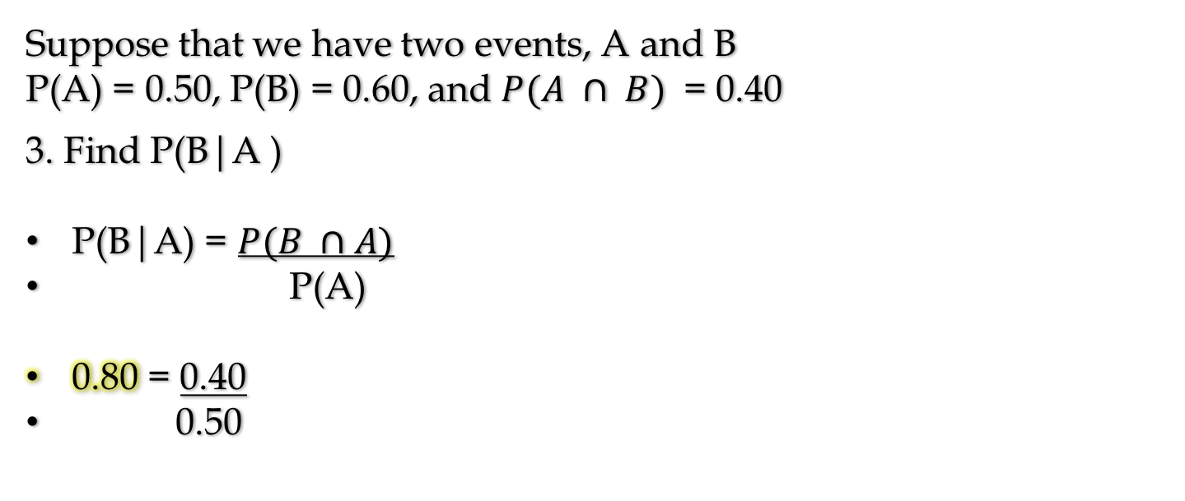
Problem 3 (Solutions)
Suppose that we have two events, A and B
P(A) = 0.50, P(B) = 0.60, and $P(A ∩ B)$ = 0.40
3. Find P(B|A )
P(B|A) = $P(B ∩A)$
P(A)
0.80 = 0.40
0.50

Slide 30
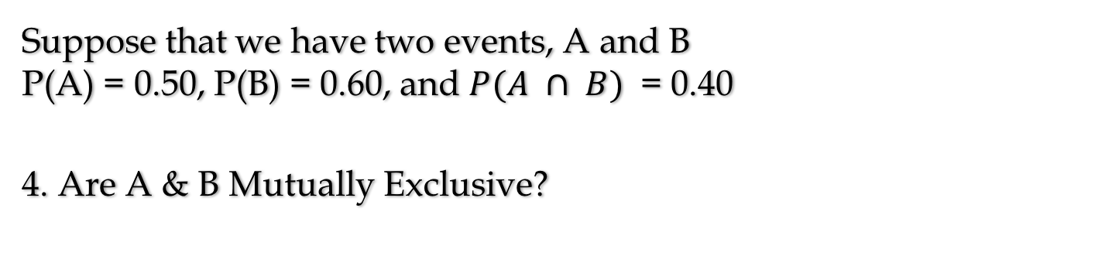
Problem 4
Suppose that we have two events, A and B
P(A) = 0.50, P(B) = 0.60, and $P(A ∩ B)$ = 0.40
4. Are A & B Mutually Exclusive?

Slide 31
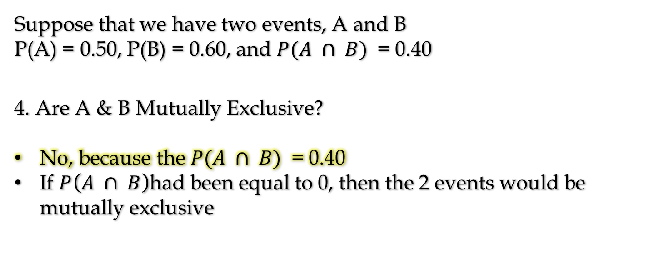
Problem 4 (Solutions)
Suppose that we have two events, A and B
P(A) = 0.50, P(B) = 0.60, and $P(A ∩ B)$ = 0.40
4. Are A & B Mutually Exclusive?
No, because the $P(A ∩ B)$ = 0.40
If $P\left(A ∩ B\right)$had been equal to 0, then the 2 events would be mutually exclusive

Slide 32
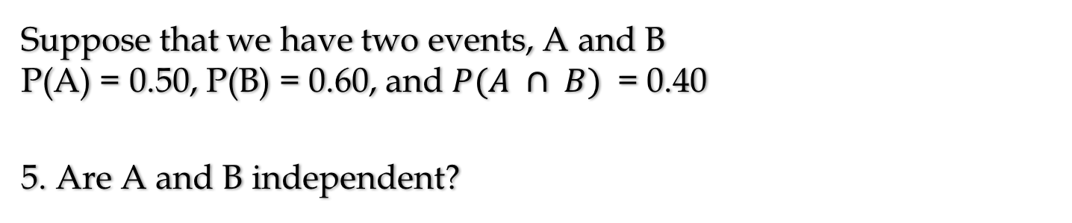
Problem 5
Suppose that we have two events, A and B
P(A) = 0.50, P(B) = 0.60, and $P(A ∩ B)$ = 0.40
5. Are A and B independent?

Slide 33
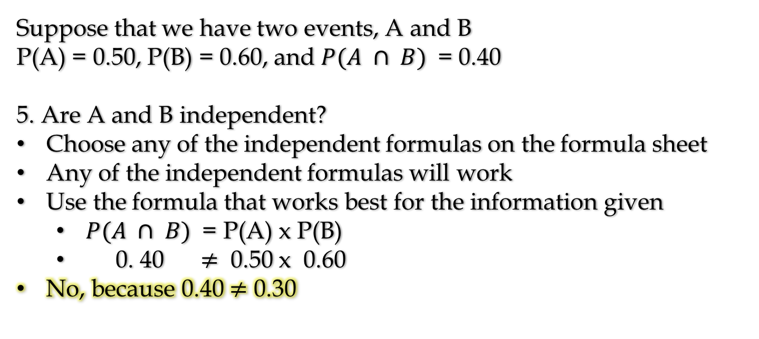
Problem 5
Suppose that we have two events, A and B
P(A) = 0.50, P(B) = 0.60, and $P(A ∩ B)$ = 0.40
5. Are A and B independent?
Choose any of the independent formulas on the formula sheet
Any of the independent formulas will work
Use the formula that works best for the information given
$P(A ∩ B)$ = P(A) x P(B)
0. 40 $≠$ 0.50 x 0.60
No, because 0.40 $≠$ 0.30

